Slide 1
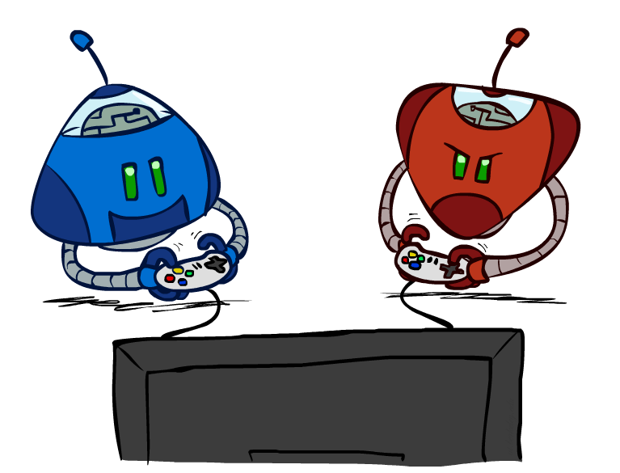
Game Playing
Artificial Intelligence

Slide 2
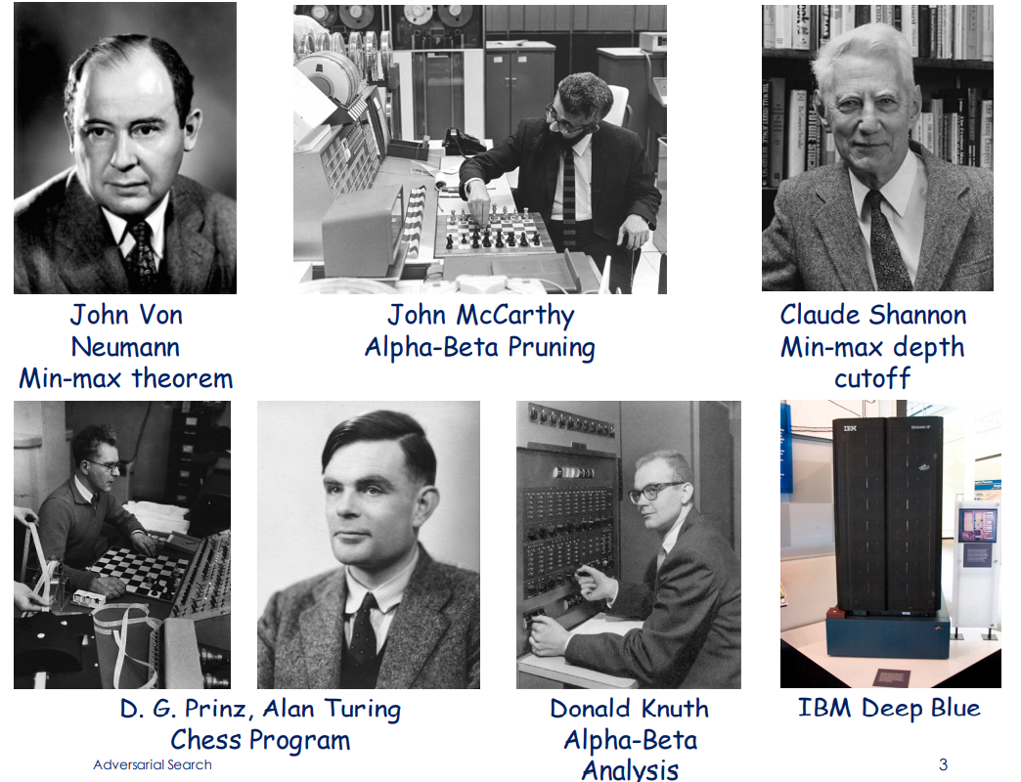
Contributors

Slide 3
Why Game
Why games?
Games like Chess or Go are compact settings that mimic the uncertainty of interacting with the natural world involving other rational agents
For centuries humans have used them to exert their intelligence
Recently, there has been great success in building game programs that challenge human supremacy
Games vs. Search Problems
"Unpredictable" opponent
Solution is a strategy
Specifying a move for every possible opponent reply
Time limits
Generally intractable search space, so agents cannot enumerate all possible winning moves
Unlikely to find goal, must approximate

Slide 4
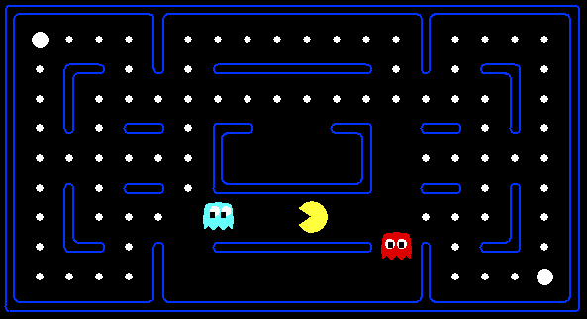
Behavior from Computation

Slide 5

Video of Demo Mystery Pacman

Slide 6
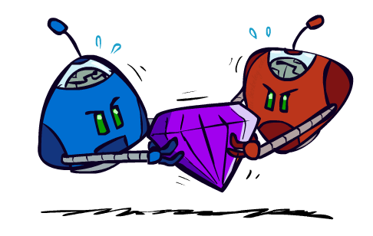
Adversarial Games

Slide 7
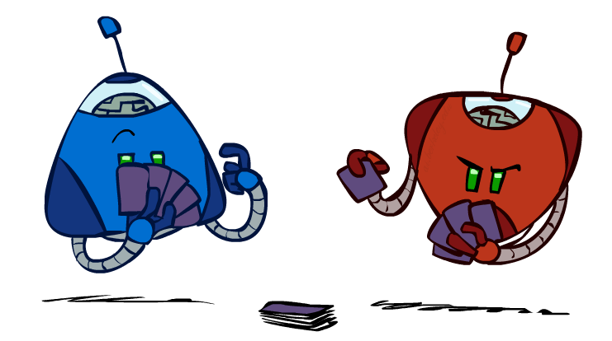
Types of Games
Many different kinds of games!
Axes:
Deterministic or stochastic?
One, two, or more players?
Zero sum?
Perfect information (can you see the state)?
Want algorithms for calculating a strategy (policy) which recommends a move from each state

Slide 8
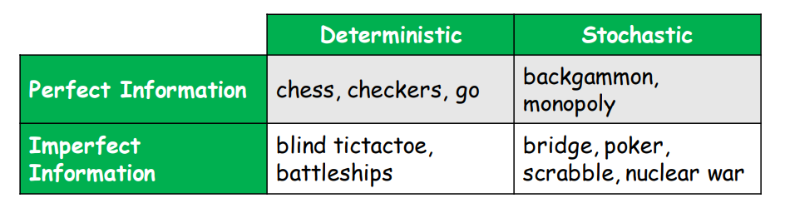
Types of Game

Slide 9
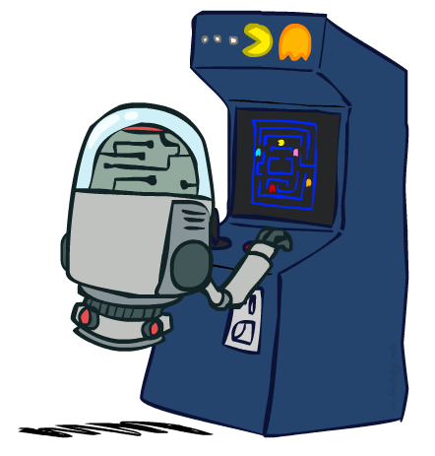
Deterministic Games
Many possible formalizations, one is:
States: S (start at s₀)
Players: P={1...N} (usually take turns)
Actions: A (may depend on player / state)
Transition Function: SxA → S
Terminal Test: S → {t,f}
Terminal Utilities: SxP → R
Solution for a player is a policy: S → A

Slide 10
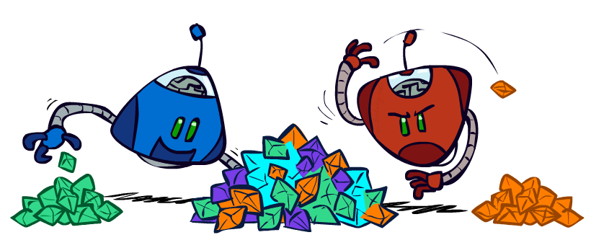
Zero-Sum Games
Zero-Sum Games
Agents have opposite utilities (values on outcomes)
Lets us think of a single value that one maximizes and the other minimizes
Adversarial, pure competition
General Games
Agents have independent utilities (values on outcomes)
Cooperation, indifference, competition, and more are all possible

Slide 11

Adversarial Search

Slide 12
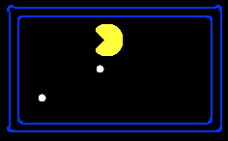
Single-Agent Trees
8
2
0
…
2
6
…
4
6

Slide 13
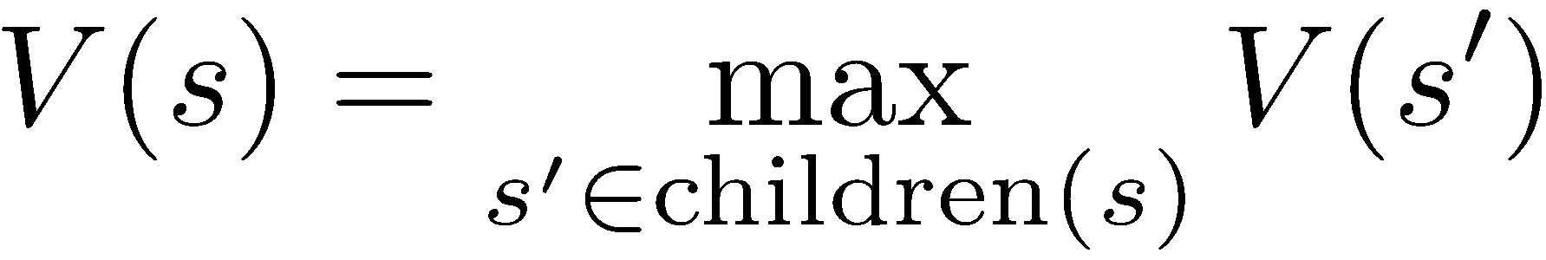
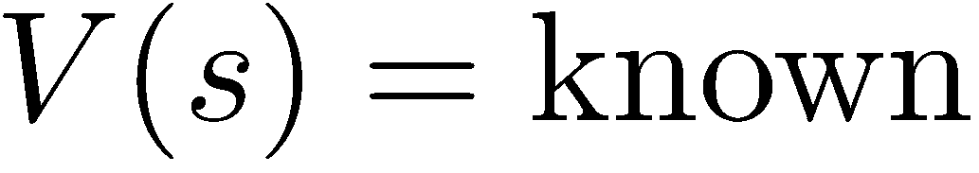
Value of a State
Value of a state: The best achievable outcome (utility) from that state
Non-Terminal States:
8
2
0
…
2
6
…
4
6
Terminal States:

Slide 14

Adversarial Game Trees
-20
-8
…
-18
-5
…
-10
+4
-20
+8

Slide 15
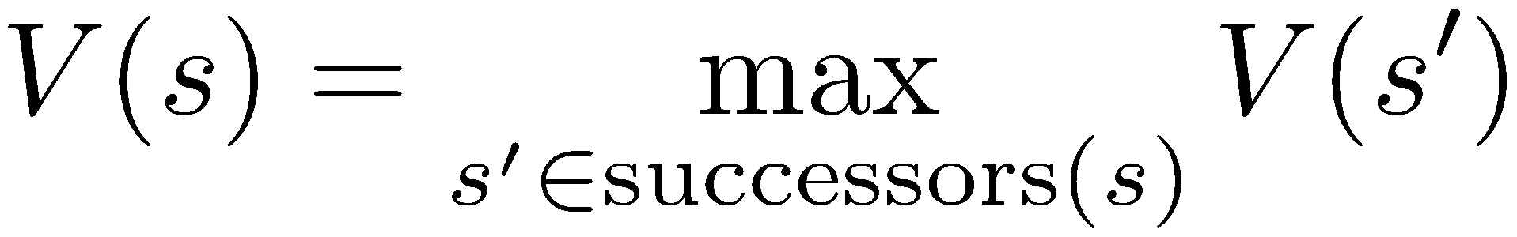
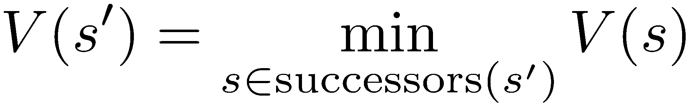
Minimax Values
States Under Agent’s Control:
States Under Opponent’s Control:
-8
-5
-10
+8
Terminal States:

Slide 16

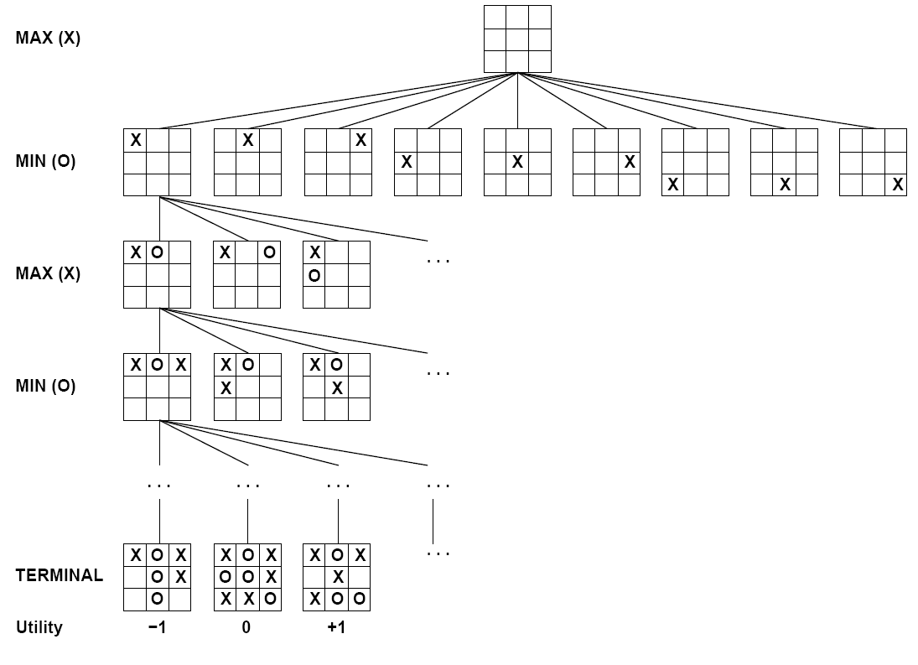

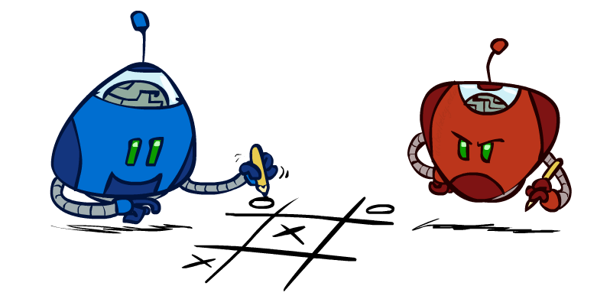
Tic-Tac-Toe Game Tree
tictactoe – 9!=362880 terminal nodes

Slide 17
Adversarial Search (Minimax)
Deterministic, zero-sum games:
Tic-tac-toe, chess, checkers
One player maximizes result
The other minimizes result
Minimax search:
A state-space search tree
Players alternate turns
Compute each node’s minimax value: the best achievable utility against a rational (optimal) adversary
Minimax values: computed recursively
5
max
2
5
min
8
2
5
6
Terminal values: part of the game

Slide 18
Minimax algorithm
Minimax algorithm
Perfect play for deterministic, 2-player game
Max tries to maximize its score
Min tries to minimize Max’s score (Min)
Goal: Max to move to position with highest minimax value
→ Identify best achievable payoff against best play

Slide 19
Minimax Implementation
def max-value(state):
initialize v = -∞
for each successor of state:
v = max(v, min-value(successor))
return v
def min-value(state):
initialize v = +∞
for each successor of state:
v = min(v, max-value(successor))
return v

Slide 20
Minimax Implementation (Dispatch)
def value(state):
if the state is a terminal state: return the state’s utility
if the next agent is MAX: return max-value(state)
if the next agent is MIN: return min-value(state)
def max-value(state):
initialize v = -∞
for each successor of state:
v = max(v, value(successor))
return v
def min-value(state):
initialize v = +∞
for each successor of state:
v = min(v, value(successor))
return v
Notes:
Pick an order for two reasons: sequential processor and pruning

Slide 21
Minimax Example
3
3
2
2
3
12
8
2
4
6
14
5
2
Notes:
Add values by hand if on tablet, or add by animation steps

Slide 22
Poll
What kind of search is Minimax Search?
BFS
DFS
UCS
A*

Slide 23
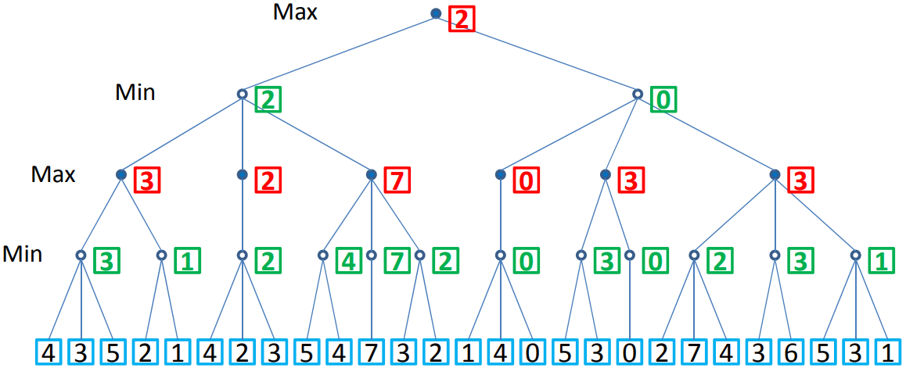
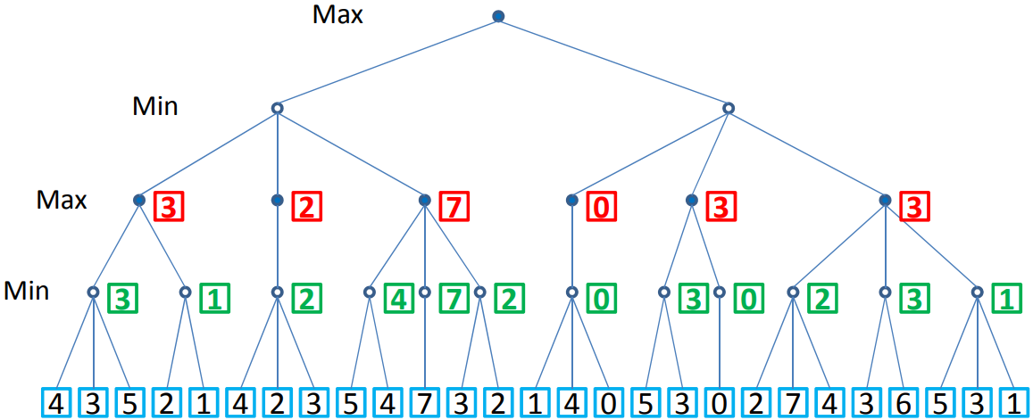
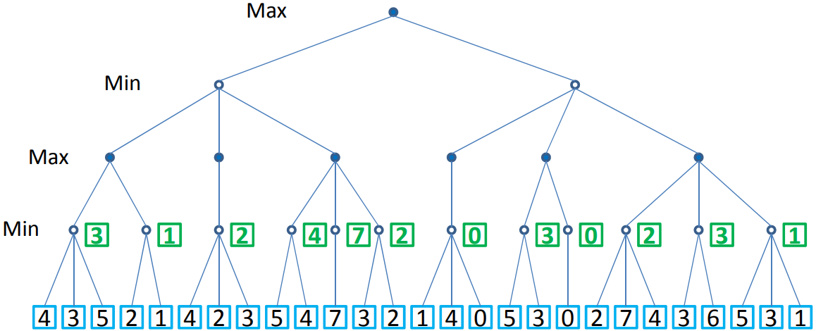
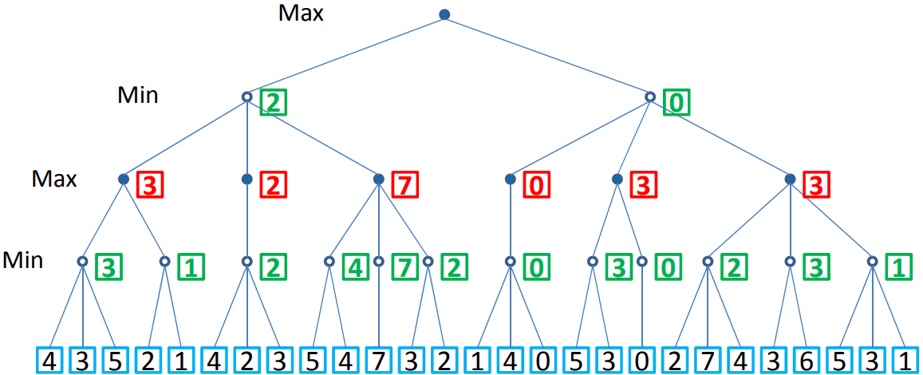
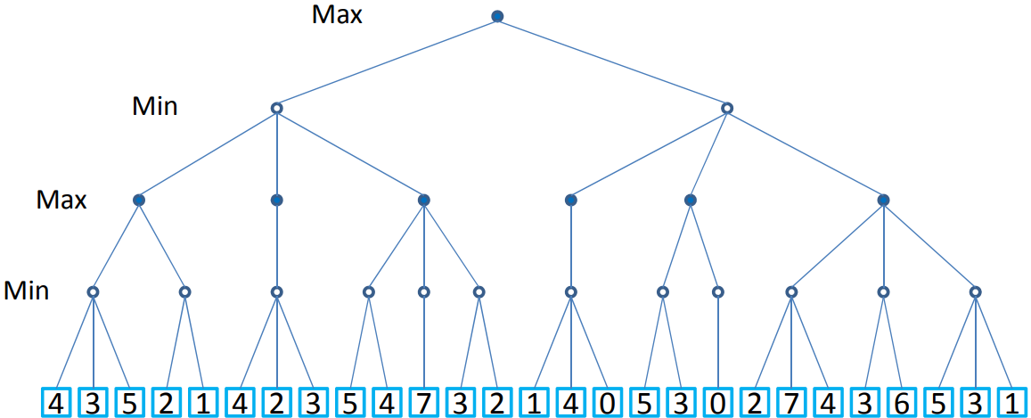
Minimax Example

Slide 24



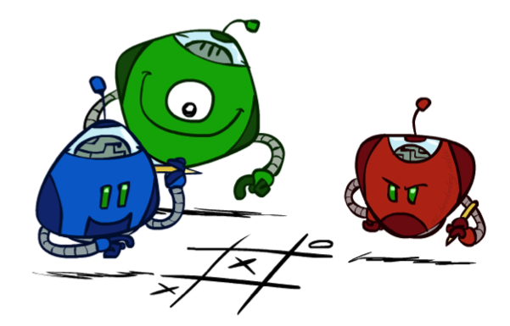
Generalized minimax
What if the game is not zero-sum, or has multiple players?
Generalization of minimax:
Terminals have utility tuples
Node values are also utility tuples
Each player maximizes its own component
Can give rise to cooperation and
competition dynamically…
8,8,1
8,8,1
7,7,2
0,0,7
8,8,1
7,7,2
0,0,8
1,1,6
0,0,7
9,9,0
8,8,1
9,9,0
7,7,2
0,0,8
0,0,7
Notes:
If both ghosts go the same way, pacman wins; if they go different ways, pacman loses

Slide 25
Minimax Efficiency
How efficient is minimax?
Just like (exhaustive) DFS
Time: O(b^{m})
Space: O(bm)
Minimax Solution
Using the current state as the initial state, build the game tree uniformly to the maximal depth m (called horizon) feasible within the time limit
Evaluate the states of the leaf nodes
Back up the results from the leaves to the root and pick the best action assuming the best play by MIN (worst for MAX)
Example: For chess, b ≈ 35, m ≈ 100
Exact solution is completely infeasible
But, do we need to explore the whole tree?

Slide 26

Resource Limits

Slide 27
Resource Limits
Problem: In realistic games, cannot search to leaves!
Solution 1: Bounded lookahead
Search only to a preset depth limit or horizon
Use an evaluation function for non-terminal positions
Guarantee of optimal play is gone
More plies make a BIG difference
Example:
Suppose we have 100 seconds, can explore 10K nodes / sec
So can check 1M nodes per move
For chess, b=~35 so reaches about depth 4 – not so good
max
4
-2
4
min
-1
-2
4
9
?
?
?
?

Slide 28
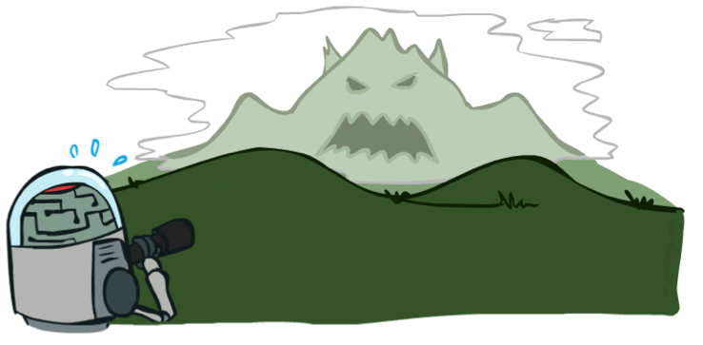

Depth Matters
Evaluation functions are always imperfect
Deeper search => better play (usually)
Or, deeper search gives same quality of play with a less accurate evaluation function
An important example of the tradeoff between complexity of features and complexity of computation
[Demo: depth limited (L6D4, L6D5)]

Slide 29
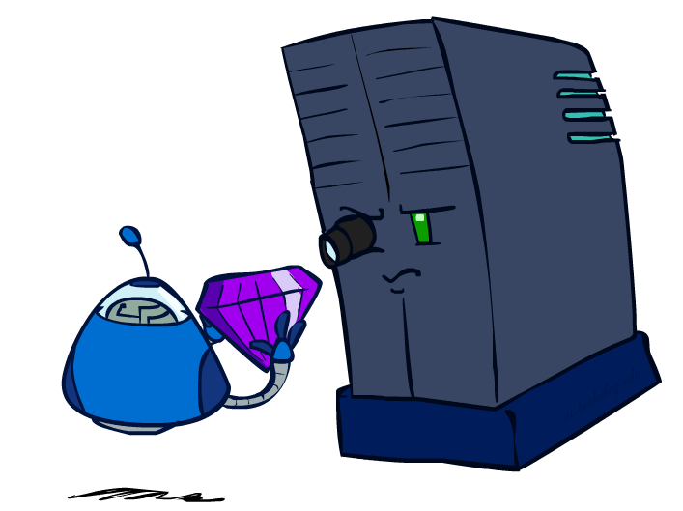
Evaluation Functions

Slide 30
Evaluation Function
Function E: state s → number E(s)
E(s) is a heuristics: estimates how favorable s is for MAX
E(s) > 0 → s is favorable to MAX (the larger the better)
E(s) < 0 → s is favorable to MIN
E(s) = 0 → s is neutral
Why using backed-up values?
At each non-leaf node n, the backed-up value is the value of the best state that MAX can reach at depth m if MIN plays well (by the same criterion as MAX applies to itself)
If E is to be trusted in the first place, then the backed-up value is a better estimate of how favorable STATE(n) is than E(STATE(n))
Features may include
Number of pieces of each type
Number of possible moves
Number of squares controlled

Slide 31
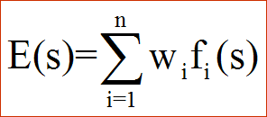
Evaluation Functions
Evaluation functions score non-terminals in depth-limited search
Ideal function: returns the actual minimax value of the position
In practice: typically weighted linear sum of features:
e.g. f₁(s) = (num white queens – num black queens), etc.

Slide 32
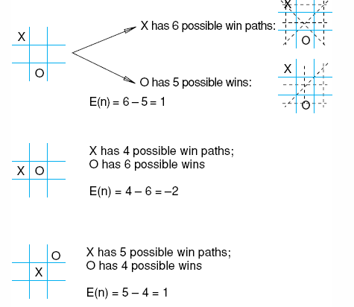
Example: A Heuristic for Tic-Tac-Toe
Heuristic: E(n) = M(n) – O(n)
M(n) = Total possible wining
lines for MAX
O(n) = Total possible wining
lines for the opponent

Slide 33
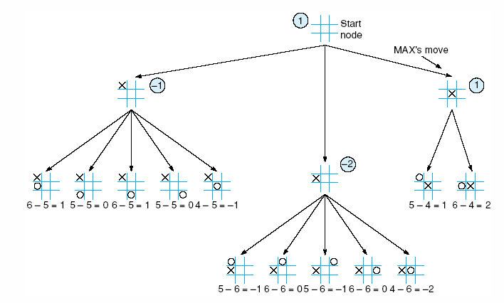
Example: 2-ply Minimax on Tic-Tac-Toe
Tic-Tac-Toe Tree at horizon 2 shows the backed up Minimax values

Slide 34
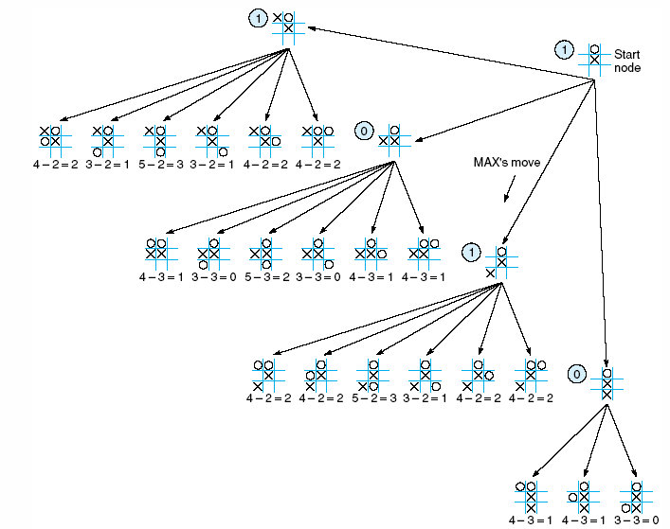
Example: Tic-Tac-Toe (cont.)
2-ply Minimax applied to one of two possible MAX second moves

Slide 35
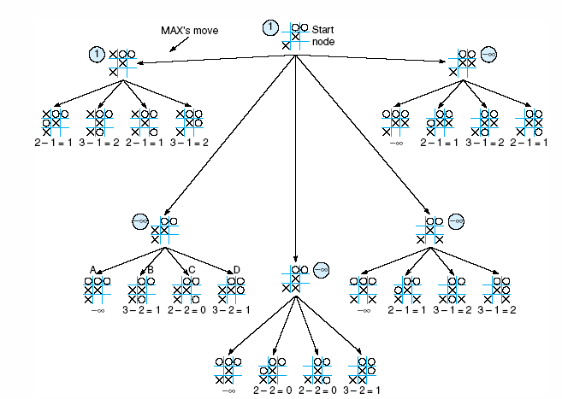
Example: Tic-Tac-Toe (cont.)
2-ply Minimax applied to X’s move near the end of the game

Slide 36
Can we do better?
Yes ! Much better !
≥ 3
3
≤ -1
← Pruning
This part of the tree can’t have any effect on the value that will be backed up to the root
-1

Slide 37
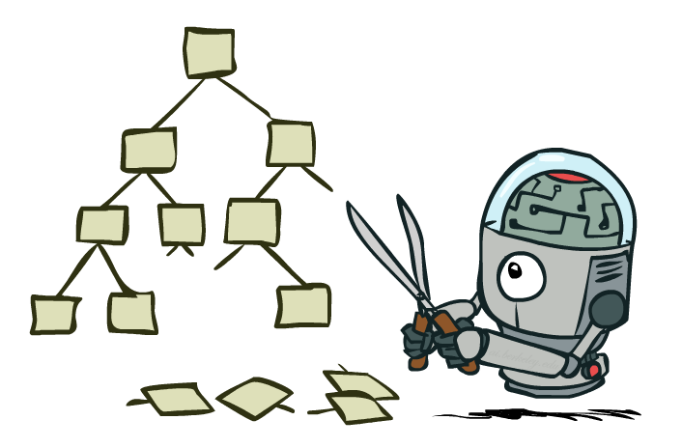
Game Tree Pruning

Slide 38
Intuition: prune the branches that can’t be chosen
3
3
2
2
3
12
8
2
4
6
14
5
2
Notes:
Add values by hand if on tablet, or add by animation steps

Slide 39
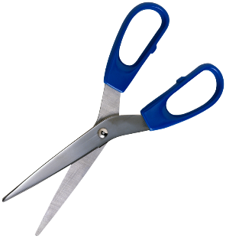
Alpha-Beta Pruning Example
α = best option so far from any
MAX node on this path
3
α =3
α =3
3
3
12
8
2
14
5
2
We can prune when: min node won’t be higher than 2, while parent max has seen something larger in another branch
The order of generation matters: more pruning
is possible if good moves come first
Notes:
Add values by hand if on tablet, or add by animation steps

Slide 40
Alpha-Beta Implementation
α: MAX’s best option on path to root
β: MIN’s best option on path to root
def max-value(state, α, β):
initialize v = -∞
for each successor of state:
v = max(v, value(successor, α, β))
if v ≥ β return v
α = max(α, v)
return v
def min-value(state , α, β):
initialize v = +∞
for each successor of state:
v = min(v, value(successor, α, β))
if v ≤ α return v
β = min(β, v)
return v
Notes:
Pick an order for two reasons: sequential processor and pruning

Slide 41
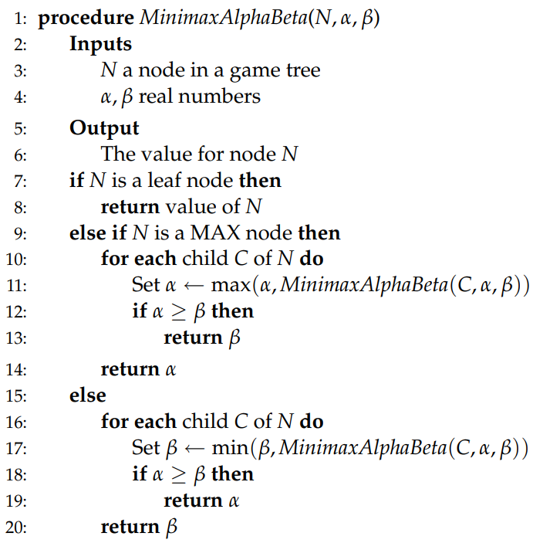
Alpha-Beta Implementation
Node Type | LEAF | MAX | MIN
Update |  | 𝛼 | 𝛽
Return | Utility Value | 𝛼 | 𝛽
Condition |  | 𝛼 ≥ 𝛽 | 𝛼 ≥ 𝛽
if Condition True Then Return |  | 𝛽 | 𝛼

Slide 42
Alpha-Beta Pruning Example
α = best option so far from any
MAX node on this path
Default = -∞
𝛽 = best option so far from any
MIN node on this path
Default = +∞
α = 3
𝛽 = +∞
α = -∞
𝛽 = +∞
α = 3
𝛽 = 2
α = 3
𝛽 = 14
α = 3
𝛽 = +∞
α = -∞
𝛽 = 3
α = 3
𝛽 = 5
α = -∞
𝛽 = +∞
α = 3
𝛽 = 2
𝛼 ≥ 𝛽
Return α
α = 3
𝛽 = +∞
𝛼 ≥ 𝛽
Return α
3
12
8
2
4
6
14
5
2
Node Type | LEAF | MAX | MIN
Update |  | 𝛼 | 𝛽
Return | Utility Value | 𝛼 | 𝛽
Condition |  | 𝛼 ≥ 𝛽 | 𝛼 ≥ 𝛽
if Condition True Then Return |  | 𝛽 | 𝛼
Notes:
Add values by hand if on tablet, or add by animation steps

Slide 43
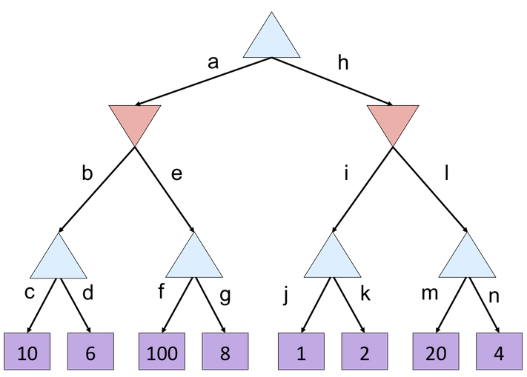
Minimax Quiz
What is the value of the top node?
A) 10
B) 100
C) 2
D) 4

Slide 44
Alpha Beta Quiz
Which branches are pruned?
A) e, l
B) g, l
C) g, k, l
D) g, n

Slide 45
For Practice
Visit this Website: https://pascscha.ch/info2/abTreePractice/

Slide 46
Alpha-Beta Pruning Properties
max
min
10
10
0

Slide 47
Alpha-Beta Pruning Properties
This pruning has no effect on minimax value computed for the root!
Values of intermediate nodes might be wrong
Important: children of the root may have the wrong value
So the most naïve version won’t let you do action selection
Good child ordering improves effectiveness of pruning
With “perfect ordering”:
Time complexity drops to O(b^{m/2})
Doubles solvable depth!
Full search of, e.g. chess, is still hopeless…
This is a simple example of metareasoning (computing about what to compute)
max
min
10
10
0

Slide 48
Additional Refinements
Waiting for Quiescence: continue the search until no drastic change occurs from one level to the next.
Secondary Search: after choosing a move, search a few more levels beneath it to be sure it still looks good.
Book Moves: for some parts of the game (especially initial and end moves), keep a catalog of best moves to make.

Slide 49
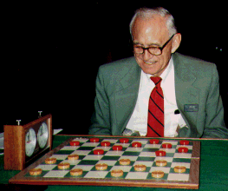
Checkers: Tinsley vs. Chinook
Name: Marion Tinsley
Profession: Teach mathematics
Hobby: Checkers
Record: Over 42 years loses only 3
games of checkers
World champion for over 40 years
1994: Mr. Tinsley suffered his 4th and 5th losses against Chinook

Slide 50
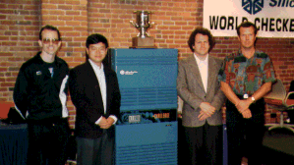
Chinook
First computer to become official world champion of Checkers!

Slide 51
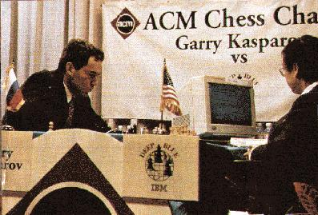
Chess: Kasparov vs. Deep Blue
Kasparov
5’10”
176 lbs
34 years
50 billion neurons
2 pos/sec
Extensive
Electrical/chemical
Enormous
Height
Weight
Age
Computers
Speed
Knowledge
Power Source
Ego
Deep Blue
6’ 5”
2,400 lbs
4 years
32 RISC processors + 256 VLSI chess engines
200,000,000 pos/sec
Primitive
Electrical
None
1997: Deep Blue wins by 3 wins, 1 loss, and 2 draws

Slide 52
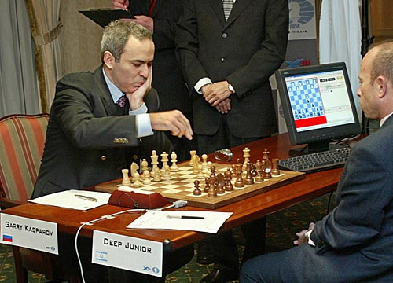
Chess: Kasparov vs. Deep Junior
Deep Junior
8 CPU, 8 GB RAM, Win 2000
2,000,000 pos/sec
Available at $100
August 2, 2003:Match ends in a 3/3 tie!

Slide 53
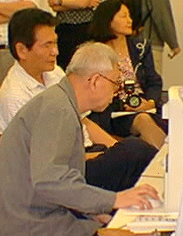
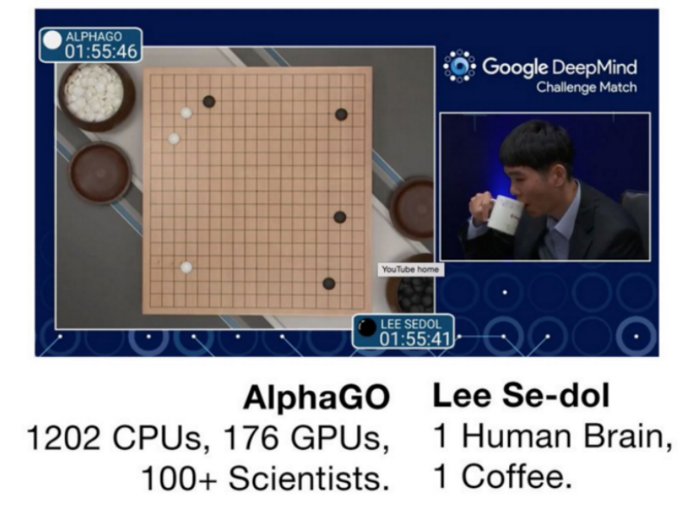
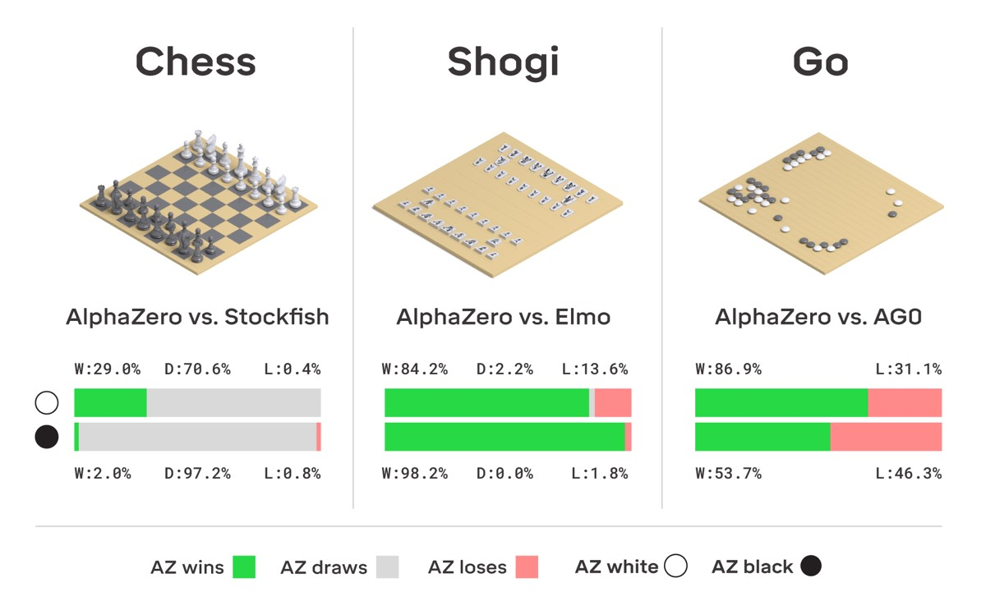
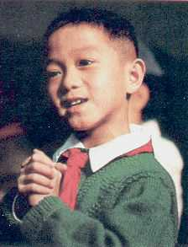
Go: Goemate vs. ??
Name: Chen Zhixing
Profession: Retired
Computer skills: self-taught programmer
Author of Goemate (arguably the best Go program available today)
Gave Goemate a 9 stone handicap and still easily beat the program, thereby winning $15,000
Go has too high a branching factor for existing search techniques. Current and future software must rely on huge databases and pattern-recognition techniques

Slide 54
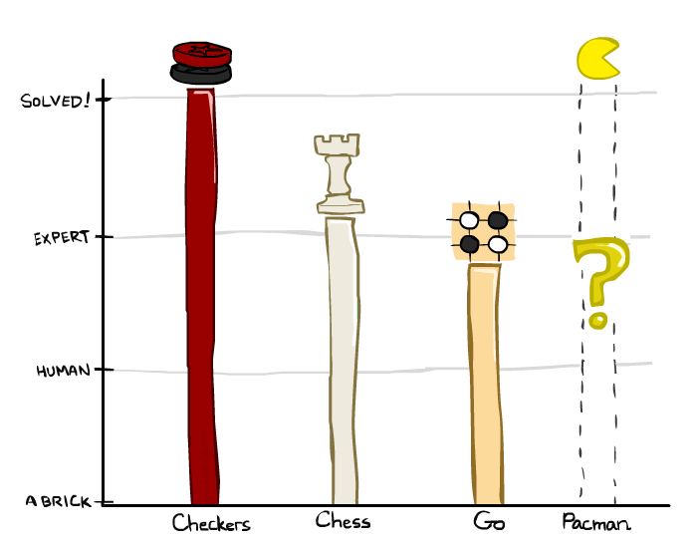
Game Playing State-of-the-Art
Checkers: 1950: First computer player. 1994: First computer champion: Chinook ended 40-year-reign of human champion Marion Tinsley using complete 8-piece endgame. 2007: Checkers solved!
Chess: 1997: Deep Blue defeats human champion Gary Kasparov in a six-game match. Deep Blue examined 200M positions per second, used very sophisticated evaluation and undisclosed methods for extending some lines of search up to 40 ply. Current programs are even better, if less historic.
Go: Human champions are now starting to be challenged by machines. In go, b > 300! Classic programs use pattern knowledge bases, but big recent advances use Monte Carlo (randomized) expansion methods.

Slide 55
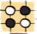
Game Playing State-of-the-Art
Checkers: 1950: First computer player. 1994: First computer champion: Chinook ended 40-year-reign of human champion Marion Tinsley using complete 8-piece endgame. 2007: Checkers solved!
Chess: 1997: Deep Blue defeats human champion Gary Kasparov in a six-game match. Deep Blue examined 200M positions per second, used very sophisticated evaluation and undisclosed methods for extending some lines of search up to 40 ply. Current programs are even better, if less historic.
Go: 2016: Alpha GO defeats human champion. Uses Monte Carlo Tree Search, learned evaluation function.
Pacman

